Slide 1
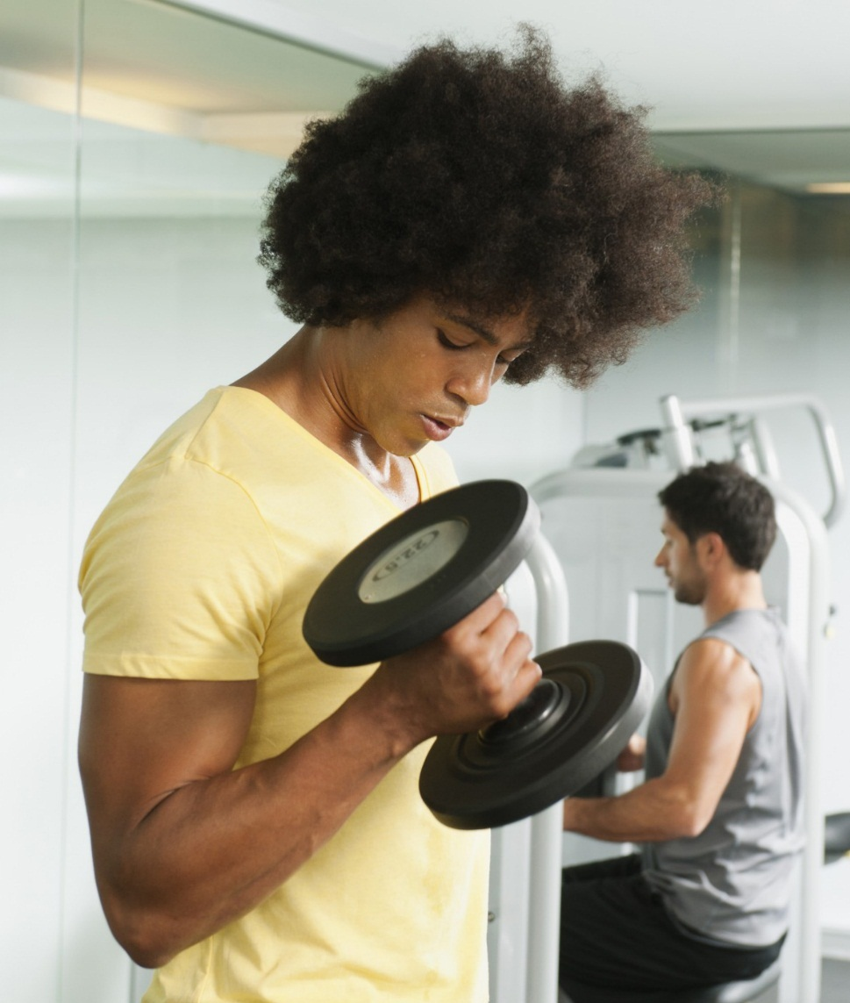
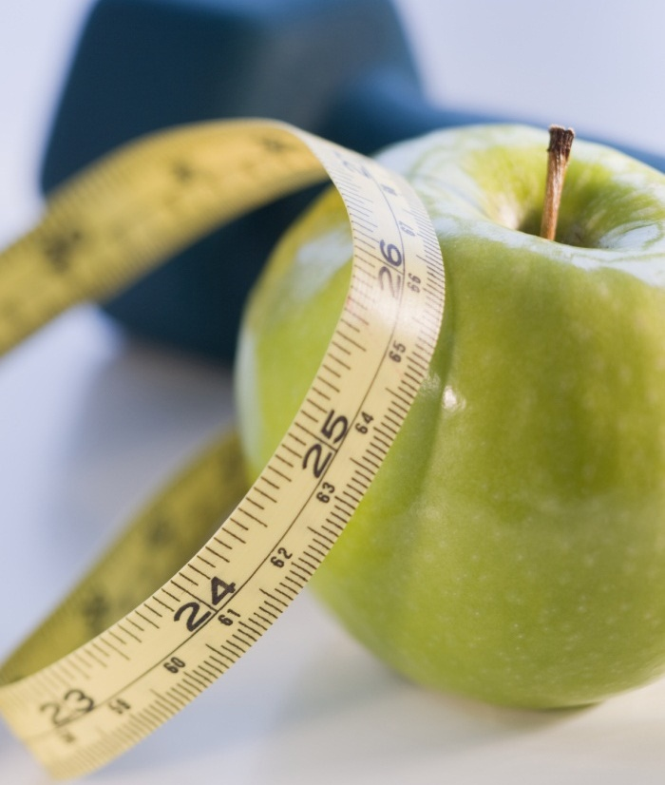
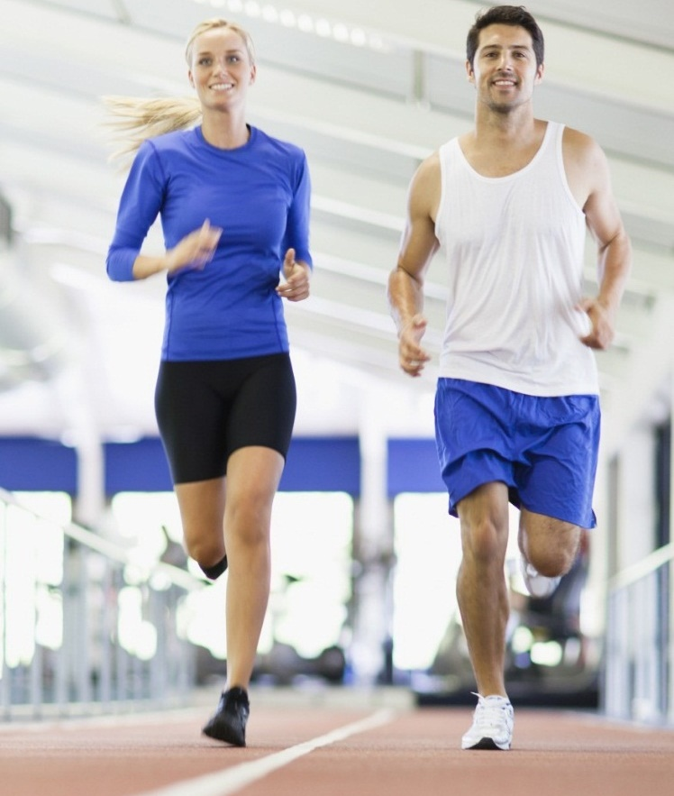
fitness and healthy advisor

Slide 2

what is this ?
1) Why I should choose this ?
2) Benefits;
3) Impact;

Slide 3
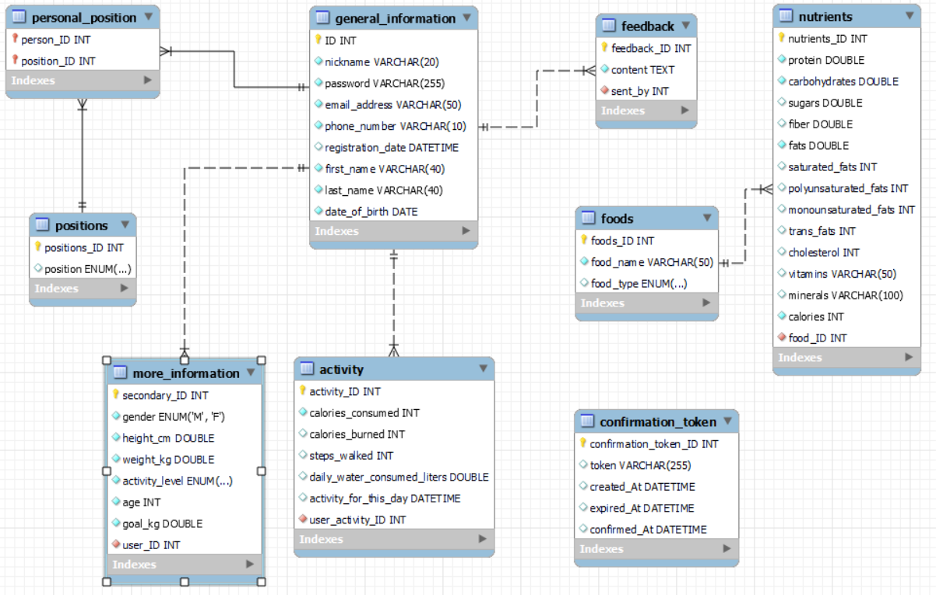
Data base core conception
User positions;
Functionality of user;
Foods and their information.

Slide 4
Work In Action
We give
You receive
Using the app
Registration

Slide 5
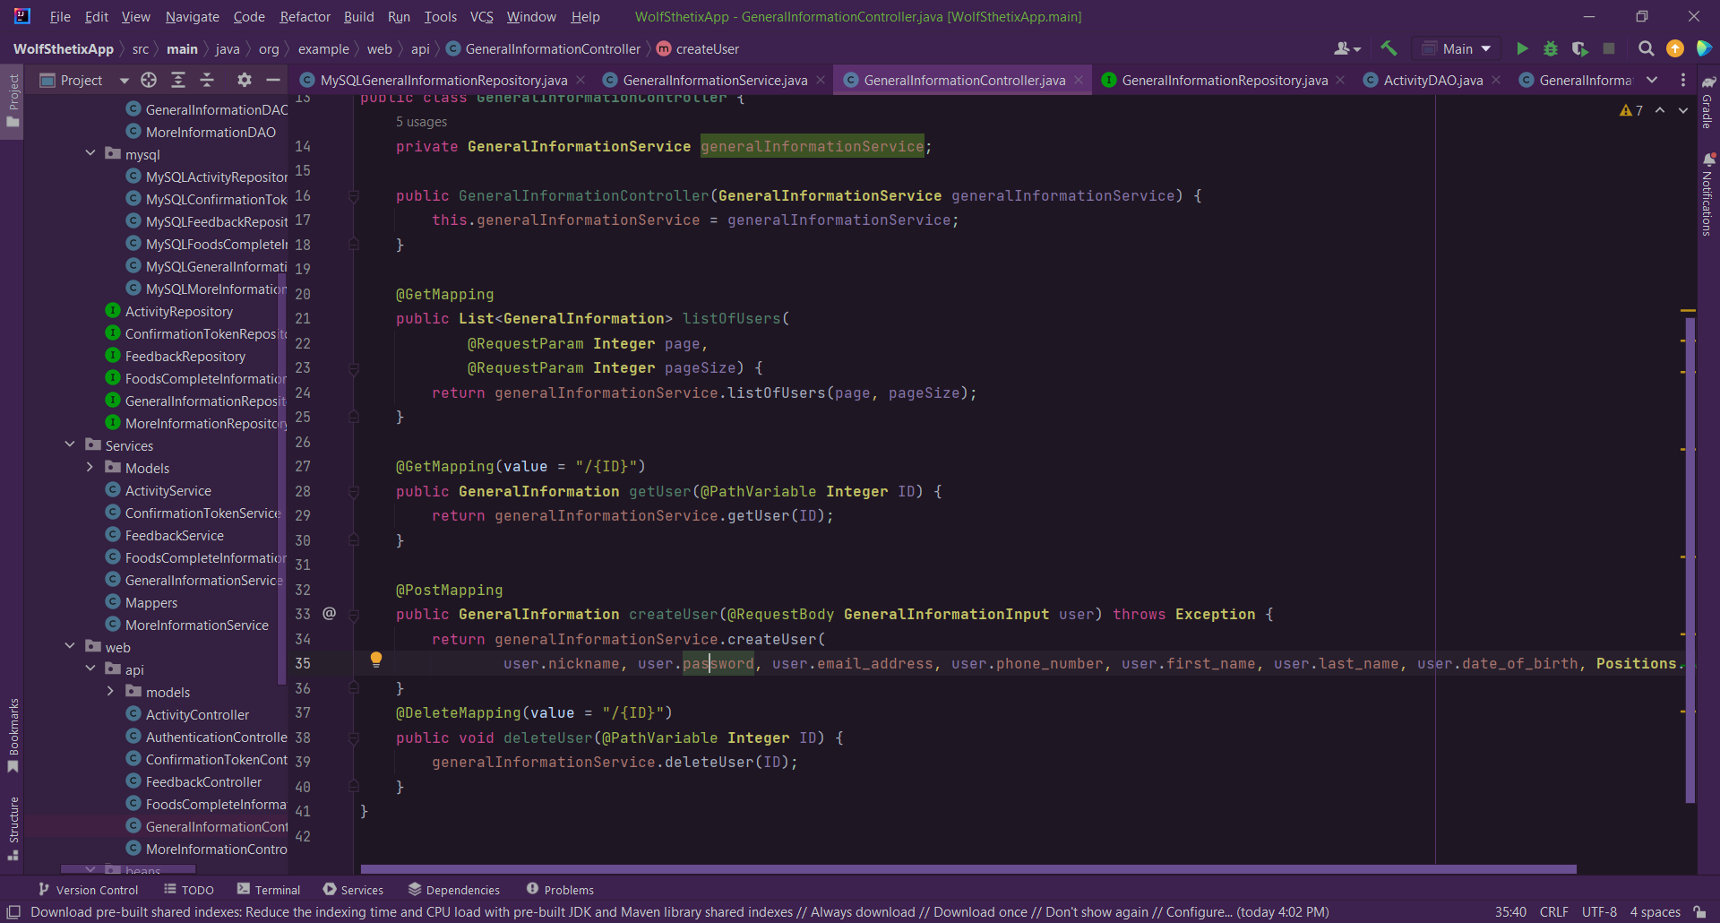
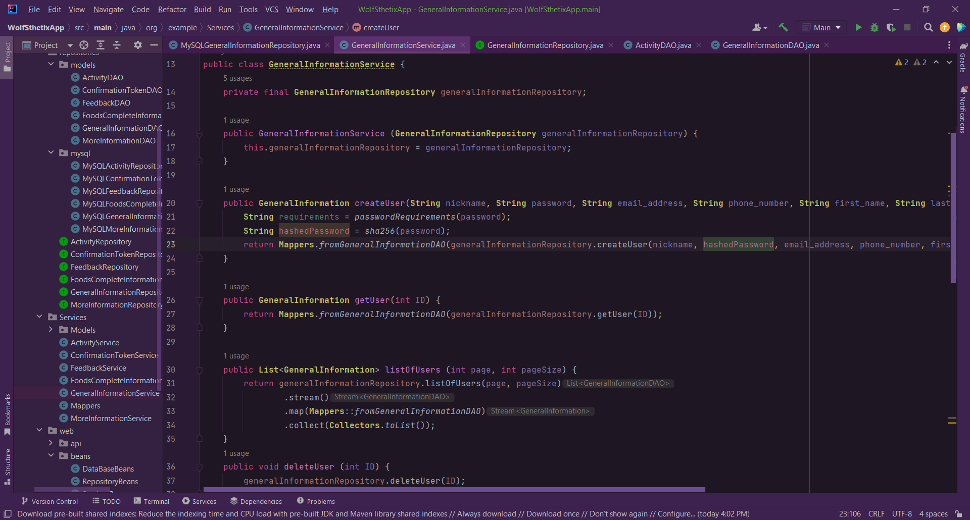
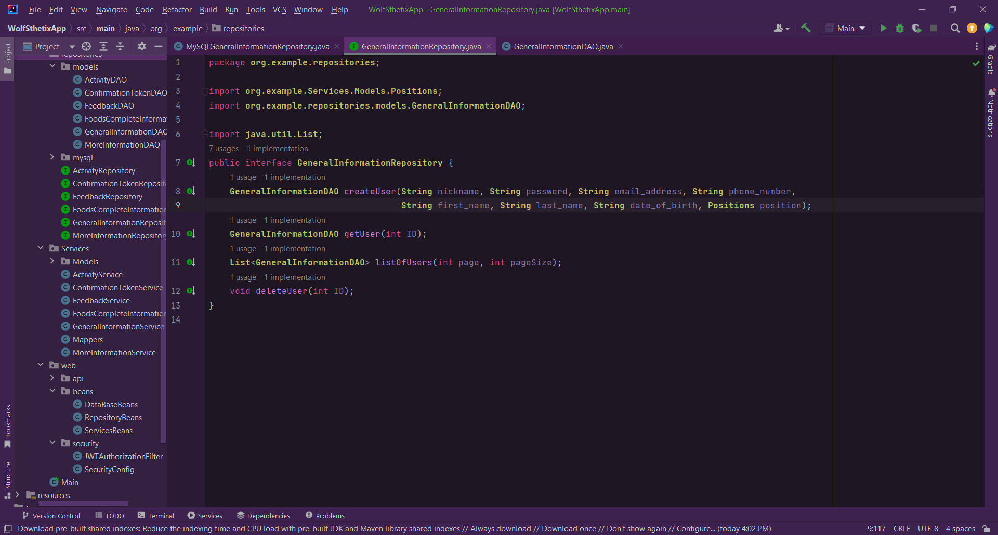
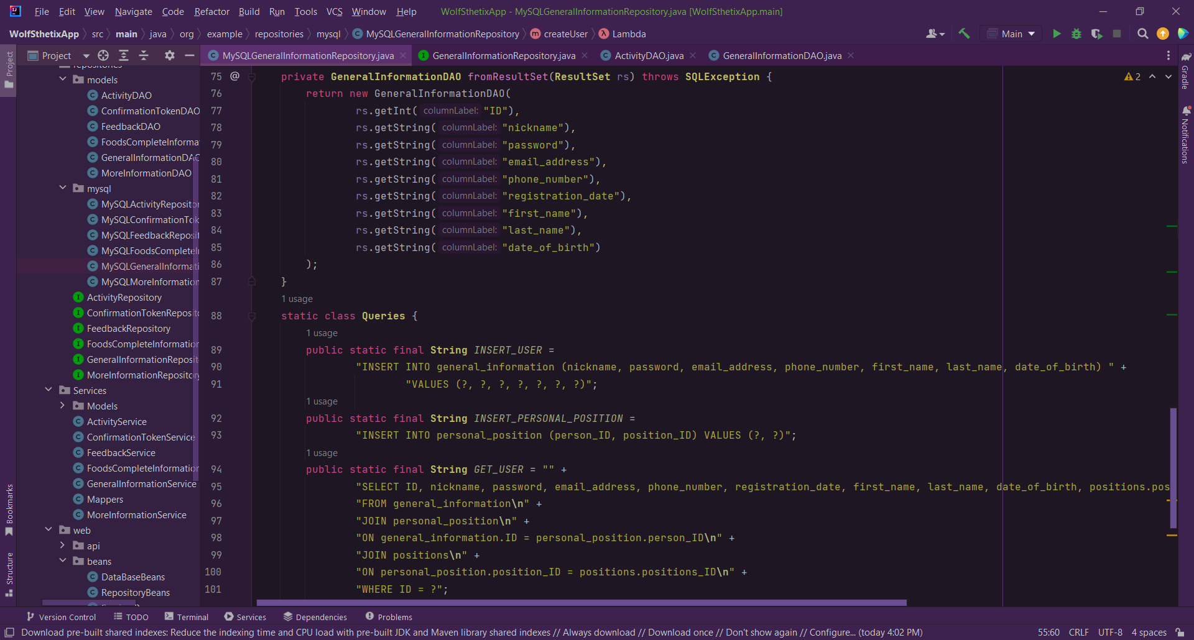
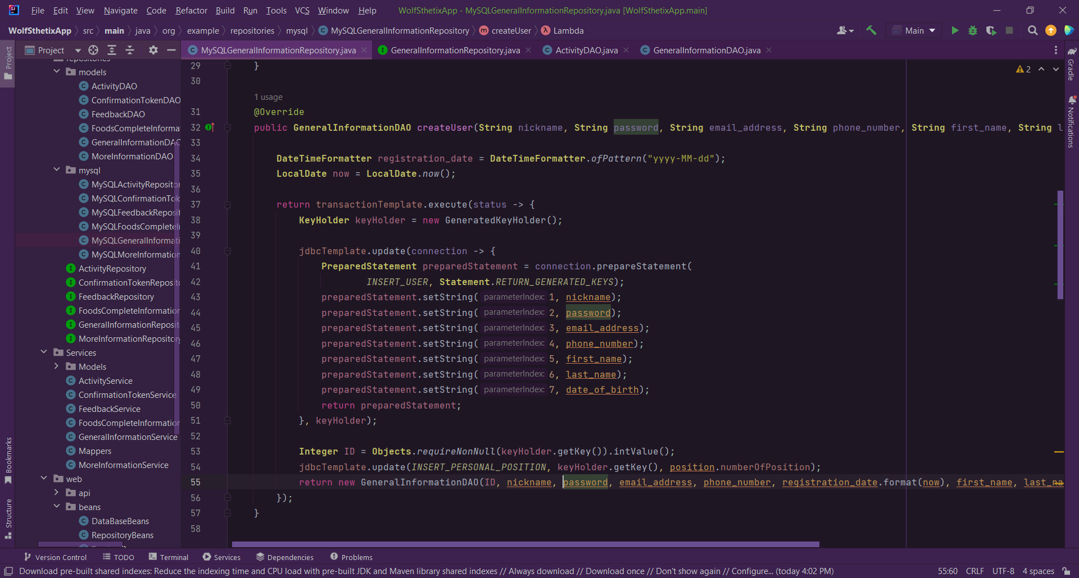
Some code

Slide 6
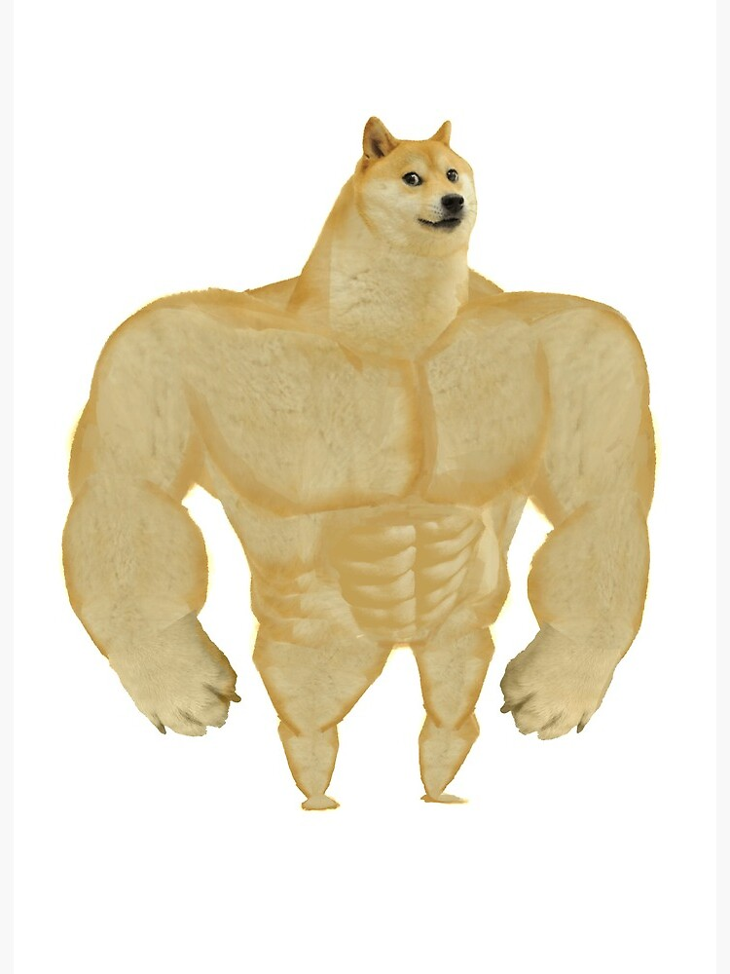

State Of the app
Current:
In the near future:

Slide 7

TODO:
More functions Like …
Formula;
Forum idea;
Last but not least: Front end.

Slide 8
Thank you for the opportunity
And thank you for your time

